Slide 1

Chapter 8:
The On-chip Network

Slide 2

Background Required to Understand this Chapter
Pipelining
Caches
Basic graph theory
Chapter 2 and 7

Slide 3

Contents
1.
Overview of an NoC
2.
Message Transmission
3.
Routing
4.
Design of a Router
5.
Non-Uniform Cache Architectures
6.
Performance Aspects

Slide 4
Layout of a Modern Chip
Cache
A mix of cores, cache banks, and memory controllers.
bank
Core
Memory
controllers
(b) Rim layout
(a) Checkerboard layout
Different layouts are suitable for different kinds of workloads.

Slide 5
Definition of a Node
Any object that can send or receive a message.
Core
Memory Controller
Cache Bank
Accelerator

Slide 6
Router
Every communicating node has a router that orchestrates the communication on its behalf.
Router
Router
Node
Channel
Data buffers

Slide 7

Key Question
How do the routers communicate with
each other?

Slide 8
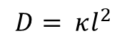
Connection between two routers with a single link.
Unbuffered link
Source
Receiver
$$D= κl^{2}$$
Quadratic relationship
D is the delay
l is the length of the wire
Long wires are very slow

Slide 9

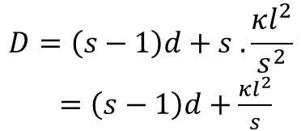
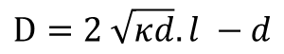
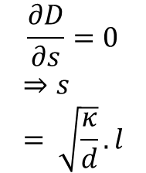
Buffered Wires
Buffered link
Source
Receiver
Buffers
s = number of segments
d = delay of a buffer
$$D=\left(s−1\right)d+s .\frac{κl^{2}}{s^{2}}$$
$=\left(s−1\right)d+\frac{κl^{2}}{s}$
$$\frac{∂D}{∂s}=0$$
$$⇒s= \sqrt{\frac{κ}{d}}.l$$
$$D=2 \sqrt{κd}.l −d$$
Delay is linear in terms of
the length

Slide 10
Multi-layer Interconnects
Vias
Metallic layers

Slide 11
Types of Interconnects in Silicon Chips
1. Local wires → These are used to connect transistors within the same functional unit.
2. Intermediate wires → Used to connect transistors across adjoining functional units.
3. Global wires → Used to connect transistors across the chip.
Most intermediate and global wires are typically buffered.

Slide 12

Simple yet Naïve Solution
Connect the routers using a bus (single set of copper wires)
Node
Node
Node
Node
Bus
Bus master
The bus master needs to grant permission to a node to transmit a message.
It becomes a point of contention.
Slow and not scalable

Slide 13
Layout of a multicore processor
Tile
Need a complex topology
Core
Cache bank
Memory
controller
Router

Slide 14
Create a Network on Chip (NoC)
Arrange a set of nodes as tiles
A router sends and receives all the messages for its tile
A router also forwards messages originating at other routers to their destination
Routers are referred to as nodes. Adjacent nodes are connected with links.
The routers and links form the on chip network, or NoC.

Slide 15
A Few Definitions
Bisection Bandwidth
Number of links that need to be snapped to divide an NoC into two equal parts (ignore small additive constants). Indicative of path diversity between two nodes. More is the path diversity more is the congestion tolerance.
Diameter
Maximum optimal distance between any two pair of nodes (again ignore small additive constants)
Aim : Maximise bisection bandwidth, minimise diameter

Slide 16
Example Topologies

Slide 17
Chain and Ring
Chain
Ring
No path diversity
Limited path diversity

Slide 18
Fat Tree
Links get wider towards the root. This ensures that the root does not become a bottleneck

Slide 19
Mesh
Every node has a degree of 4 other than at the rims and corners

Slide 20
Torus
Every node has a degree of 4
The long links cause an issue.

Slide 21
Folded Torus
Problem of long links gets solved.

Slide 22
High-Radix Topologies
Nodes are connected to more than 4 neighbors
Additional path diversity
Low diameter
Hard to implement it in an NoC
Much easier to implement in a cluster computer
Hypercubes
Clos network
Butterfly

Slide 23
Hypercube
00
01
000
001
0
0
1
010
011
100
101
10
H
11
110
111
H
H
1
2
0
H
(c)
3
(d)
(a)
(b)
H
4
(e)

Slide 24
Properties of a Hypercube
If a hypercube has N nodes
Diameter → log₂(N)
Bisection bandwidth → N/2
It is a recursive data structure
Connect two copies of an order (N-1) hypercube
by connecting corresponding nodes together.

Slide 25
Clos Network (nr inputs and outputs)
Three-layer network
m r x r
r n x m
3x3 switch
r = 3
m = 4
n = 4
r m x n
4x4 switch

Slide 26
Properties of a Clos Network
If m >= n, we can always connect an unused input terminal to an unused output terminal by rearranging the rest of the connections.
If m >= 2n – 1, we can do the same without rearranging the rest of the connections.

Slide 27
Butterfly
1
1
00
00
00
Only uses 2x2 switches
2
2
3
3
01
01
01
4
4
5
5
10
10
10
6
6
7
7
11
11
11
8
8
Efficient implementations with high-radix routers exist.

Slide 28
Summary
Topology | #Switches | #Links | Diameter | Bisection Bandwidth
Chain | 0 | N-1 | N-1 | 1
Ring | 0 | N | N/2 | 2
Fat Tree | N-1 | N log(N)* | 2 log(N) | N/2*
Mesh | 0 | 2N - 2√N | 2√N – 2 | √N
Torus | 0 | 2N | √N | 2√N
Folded Torus | 0 | 2N | √N | 2√N
Hybercube | 0 | N log(N)/2 | log(N) | N/2
Butterfly | N log(N)/2 | N + N log(N) | log(N) + 1 | N/2
* Assume that the size of each link is equal to the number of leaves in its subtree

Slide 29
Contents
1.
Overview of an NoC
2.
Message Transmission
3.
Routing
4.
Design of a Router
5.
Non-Uniform Cache Architectures
6.
Performance Aspects

Slide 30

Hierarchy of messages sent in a NoC
Message
Packet
Flit
Phit

Slide 31
Description
Message → Set of bytes sent from a sending node to a receiving node
Packet → A message is broken into multiple packets.
All the bytes in a packet take the same route.
Flit → Flow control digit: size is 8 bytes or 16 bytes. An atomic unit of bytes. A router never breaks a flit.
Phit → Physical digit. While transmitting a flit, it might take multiple cycles. If we can send 32 bits at a time, then transmitting a 128-bit flit will take 4 cycles. In each cycle we send a 32-bit phit.
Head flit
Body flit
Body flit
Tail flit

Slide 32
Flow Control
Transmission of a single flit
Buffers at the sender’s side
Buffers at the receiver’s side
What do we do if we do not have enough buffer space at the receiver’s side?
We are not allowed to drop a flit.
Have some information at the sender about the free buffer space available at the receiver.

Slide 33
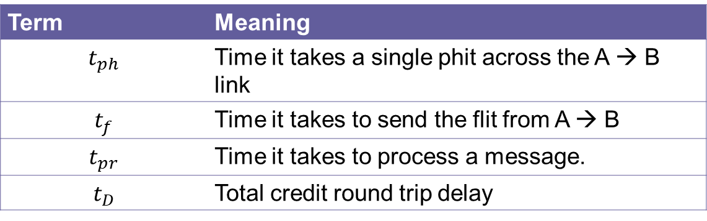
Credit Based Flow Control
The sender (A) maintains an estimate of the number of free buffers at the receiver (B).
If the sender thinks that the receiver has enough free buffers, then only it sends a flit.
Once the receiver frees a buffer it sends a credit to the sender
Term | Meaning
$$t_{ph}$$ | Time it takes a single phit across the A → B link
$$t_{f}$$ | Time it takes to send the flit from A → B
$$t_{pr}$$ | Time it takes to process a message.
$$t_{D}$$ | Total credit round trip delay

Slide 34
Assumptions
The routers are clock synchronized.
Time is measured in the units of “router cycles”. All delays are an integral number of router cycles.
We first receive a message, then process it, and then add it to a buffer.
All the status messages (credits, on, off, etc.) are 1 phit each

Slide 35
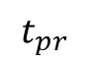
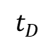
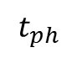
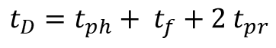
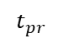
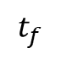
Process of Sending Credits
Round trip delay
Node A
Node B
time t
Buffer freed
$$t_{ph}$$
Credit received
$$t_{pr}$$
$$t_{D}$$
Processing
$$t_{f}$$
$$t_{pr}$$
$$t_{D}=t_{ph}+ t_{f}+2 t_{pr}$$
Flit received

Slide 36
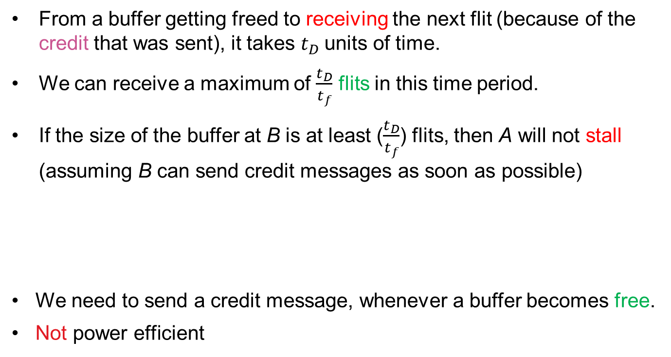
Properties of Credit Based Flow Control
From a buffer getting freed to receiving the next flit (because of the credit that was sent), it takes $t_{D}$units of time.
We can receive a maximum of $\frac{t_{D}}{t_{f}}$ flits in this time period.
If the size of the buffer at B is at least ($\frac{t_{D}}{t_{f}}$) flits, then A will not stall (assuming B can send credit messages as soon as possible)
We need to send a credit message, whenever a buffer becomes free.
Not power efficient
Disadvantage

Slide 37
Improvement: On-Off Flow Control
Channel: A → B
Improvement over normal credit-based flow control
Off-threshold (N_{OFF})
If we have N_{OFF} free buffers in B, then it immediately sends a message to A to stop sending
On-threshold (N_{ON})
If the number of free buffers in B is equal to N_{ON} , then it sends a message to A to start sending

Slide 38
Graphical Description

Slide 39

Analysis: Off message
A
B
t - t_{f} - t_{pr}
flit
Risky
period
t
t + t_{ph}
t + t_{ph} + t_{pr}
OFF message
How long is the risky period (during which packets are sent to B), after B has sent the OFF message?
(t + t_{ph} + t_{pr}) – (t – t_{f} - t_{pr}) = t_{ph} + t_{f} +2t_{pr} = t_{D}
After sending the OFF message, B can receive t_{D}/t_{f} flits
It needs to have enough buffer space available

Slide 40

The equation for N_{OFF}
Because we cannot drop flits, we have:
$$N_{OFF}≥ \frac{t_{D}}{t_{f}}$$

Slide 41

Analysis: ON message
Necessary condition:
$$N_{ON}>NOFF$$
If N_{ON} = N_{OFF} + 1
After we receive 1 message, we will have to send an OFF message
Very inefficient
To avoid frequent ON and OFF messages, there should be a sizeable gap between the thresholds, such that we can transmit in one go without frequent stop-and-start messages.

Slide 42

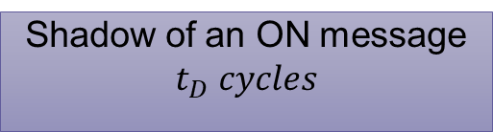
Better estimate for N_{ON}
A
B
Assume N_{ON} is equal to the number of buffers → We cannot send a single message in this period.
OFF message
ON message
Shadow of an ON message
$$t_{D} cycles$$
This means that N (number of buffers) should be far greater than N_{ON}
N – N_{ON} is the number of buffers with messages. It should be more than a threshold.

Slide 43

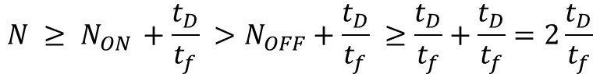
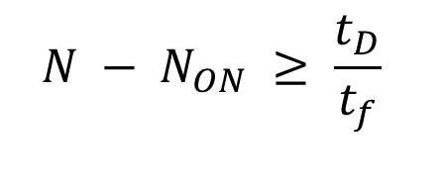
Better estimate for N_{ON} - II
If B has N flit buffers and the following conditions hold:
$$N − N_{ON} ≥ \frac{t_{D}}{t_{f}}$$
We can keep transmitting flits in the shadow of an ON message. We will have enough flits.
We thus have:
$$N ≥ N_{ON }+\frac{t_{D}}{t_{f}} >N_{OFF}+\frac{t_{D}}{t_{f}} ≥\frac{t_{D}}{t_{f}}+\frac{t_{D}}{t_{f}}=2\frac{t_{D}}{t_{f}}$$
$$N >2\frac{t_{D}}{t_{f}}$$

Slide 44
Transmission of Messages
on the NoC

Slide 45

Circuit Switching
Destination
Very slow
Source
Reserve buffer space in the routers along the way
Once the entire path is reserved, then send a message
After sending the message, clear the buffers

Slide 46
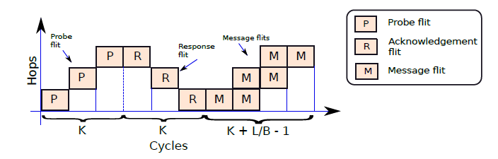
Space-time diagram
L = Length of the message in flits
K = Number of hops/ cycles to reach the destination (assumption: 1 cycle per hop)
B = channel bandwidth: flits per cycle
S
1
1
2
2
3
D
Assumptions
Takes 1 cycle to traverse a hop. B divides L and B ≥ 1
Total time:
3K + L/B - 1
K = 3, L = 2, B = 1

Slide 47


Advantages and Disadvantages
Once a circuit is established, we can transfer as may bytes as we want.
This is good for bulk transfers.
Large overheads for a single transfer.
Locks up resources for more time than the actual requirement.

Slide 48
Packet based Flow Control: Store and Forward (SAF)
Send a packet to a router (set of flits), store the entire packet, and then forward it to the next router.
Router
Router
Router
K * L / B cycles
M
M
Hops
M
M
M
M
L/B
Cycles

Slide 49
SAF Protocol
When the flits are being sent, we wait for the entire packet to be buffered.
This is a waste of time. We can send flits to the next router on the way.
Analysis: Total time required → K * L/B

Slide 50
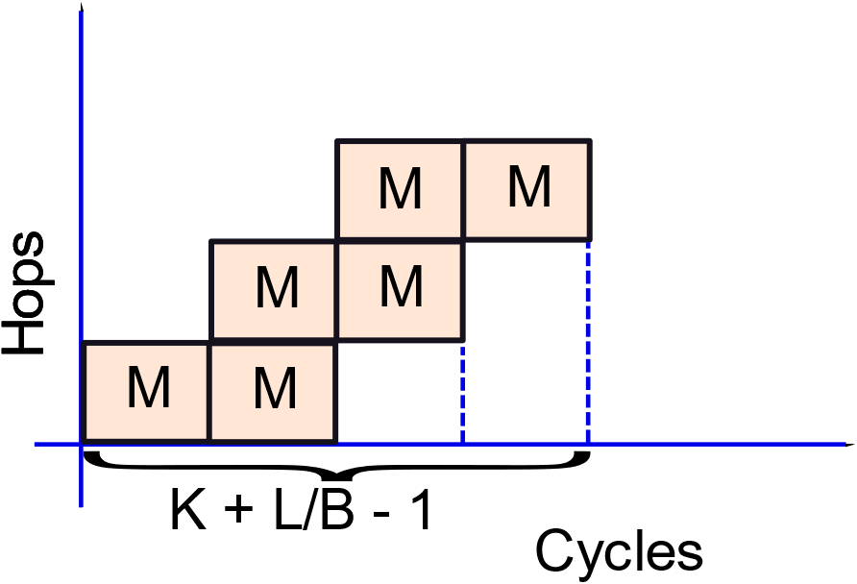

Virtual Cut-Through Routing (VCT)
Router
Router
Router
Even though we send flits before the entire packet is buffered, we need to ensure that there is space
for the entire packet.

Slide 51

Problems in the VCT Scheme
Flit from packet 1 destined to C
A
B
C
Flit from packet 2 destined to D
Flit from packet 3 destined to a node
beyond D
D
We cannot send any flit from packet 1 till the router at B is totally empty because we need to buffer the entire packet.

Slide 52
Comparison of Circuit Switching with Packet-level Switching
Scheme | Time in cycles
Circuit Switching | 3K + L/B – 1
Store and Forward (SAF) | K * L/B
Virtual Cut Through (VCT) | K + L/B - 1

Slide 53


Solution: Buffer at the Flit Level
A
B
C
Wormhole Flow Control
D
We do not have to wait for space to be created to buffer the entire packet.
The flow control is at the level of flits.
Does not solve all our problems.

Slide 54

Problem with Wormhole Flow Control
Head of the Line Blocking
Flit from packet 1 Route: A → B → C
A
B
C
D
The black flits can go to C, however, the orange flits are
blocking them.

Slide 55

Solution: Virtual Channels (VCs)
Multiplex a single physical channel among different virtual channels. Have a separate buffer queue for each virtual channel.
A
B

Slide 56
Virtual Channels: Two per physical channel
A
B
C
Each physical channel split into two virtual channels.
No HoL blocking.
D

Slide 57
Virtual Channels: Pros and Cons
There is no head of the line (HoL) blocking.
Increases throughput significantly.
We can multiplex a single physical channel among different virtual channels.
Increases the complexity of the router.
We now need to assign the virtual channels in a router (additional work).

Slide 58
Contents
1.
Overview of an NoC
2.
Message Transmission
3.
Routing
4.
Design of a Router
5.
Non-Uniform Cache Architectures
6.
Performance Aspects

Slide 59

Aim of Routing
Send a message from a sender to a receiver
Via a path of intermediate routers
Good to have a choice of multiple routes → path diversity
What is a good route?
Shortest path?
Shortest time?
Good routes typically minimize the latency, and are also fair → do not unnecessarily penalize other packets

Slide 60
Problems to avoid …
Deadlocks
Livelocks
Starvation

Slide 61

Avoid Deadlocks
Photo by Jens Herrndorff on Unsplash

Slide 62
Meaning of a Deadlock
No car can make any progress.

Slide 63

Deadlock in an NoC
Assume a buffer size of 1 flit
No progress …

Slide 64
Livelock
Flits continuously get transmitted, but they never reach their destination
They keep moving in infinite loops
These routing algorithms never terminate.
A certain flit never makes progress (never moves towards its destination). It has the lowest priority, its router always transmits other flits.
Both the problems can be solved by implementing ageing. The longer a flit stays in a router, the higher is its priority.
Starvation
Solution: Ageing

Slide 65
Dealing with Deadlocks
Deadlock in a circuit-switched system.
Packet | Source | Destination | Holds channel | Wants channel
P₁ | D | B | 1 | 2
P₂ | A | C | 2 | 3
P₃ | B | D | 3 | 4
P₄ | C | A | 4 | 1
Deadlock

Slide 66


Resource Dependence Graph (RDG)
There is an arrow from channel j to packet P_{i}, if the packet P_{i} holds the right to transmit on channel j.
There is an arrow from P_{i} to channel j, if the packet P_{i} is waiting for channel j to become free.
A cycle in the RDG implies a deadlock.

Slide 67

Channel Dependence Graph (simplified version of the RDG)
There is an arrow from Channel A
to Channel B if the packet (message)
that owns Channel A is waiting to
get access to Channel B.
A cycle in the CDG implies a deadlock.

Slide 68

We can even have deadlocks with virtual channels →
1₀ → 0th VC of physical channel 1
1₁ → 1st VC of physical channel 1

Slide 69
Turn Graphs
Disadvantage of CDGs and RDGs
They lose the orientation information of the channels.
Basic Steps
Consider a path C in the channel graph.
The TG contains all the nodes and channels belonging to C. It preserves the orientations of the channels. It does not contain any other channel.
We insert a new node called the channel node in the middle of each edge/channel.
There is a path C in the CDG → There is a path having the same channel nodes in the TG (and vice versa)
A cycle in the CDG → A cycle in the TG

Slide 70
Illustration of a TG (Turn Graph)
CDG
Original Graph
3
D
C
4
2
1
TG
A
B
D
3
C
Channel | Src → Dest
1 | A → B
2 | B → C
3 | C → D
4 | D → A
4
2
A
1
B

Slide 71

Properties of the TG
Every edge in the CDG translates to either a set of collinear nodes in the TG, or a turn in the TG.
Every cycle in the CDG is also a cycle in the TG.
Every cycle in the CDG can be translated to a sequence of straight paths and turns in the corresponding TG
Aim:
Ensure that there are no cycles in the turn graph (TG).
Try to introduce routing protocols that are provably deadlock free (their TGs will never have cycles).

Slide 72



Dimension-Ordered Routing (X-Y Routing)
Route along the x-axis first
Then send the message along the y-axis
If we have n dimensions, we can order them, and route the message first along dimension 1, then dimension 2, and so on.

Slide 73

Assume that the TG has a cycle
We either have a clockwise cycle.
Or an anti-clockwise cycle.
The C_{k} →C_{k+1} turn is not allowed. A packet is traversing in the y
direction first, and then in the x direction.
Example: anti-clockwise cycle
Can be proven for all the other cases
Hence, the TG does not have any cycles → No deadlocks

Slide 74
Problems with X-Y routing
It is simple.
X-Y routing has no path diversity. The route is fixed.
The algorithm cannot adapt to congestion.

Slide 75
Oblivious Routing (Valiant’s Algorithm)
Choose a point P at random
Send the message from the source to P, and then from P to the destination.
Deals with congestion much better by providing path diversity.
The routes can be very long and sub-optimal.

Slide 76
Minimally Oblivious Routing
Create a window around B.
Send the message from the source to P (any node within the window),
and then from P to the destination.
The computed routes are not very long.
Reduced path diversity.

Slide 77
Adaptive Routing: Theory of Turns
We can have two kinds of
cycles: clockwise and anti-
clockwise.
There are 8 possible turns.
Out of these we can allow only 6
turns (at the most). We have to
remove one turn from each cycle
to prevent a cycle from forming in
the turn graph.
Clockwise
Anticlockwise

Slide 78


Types of Routing Algorithms based on Turns
X-Y Routing
Disallow one of the turns in each cycle.
We have 4 choices per cycle:
(clockwise or anti-clockwise). We thus have a total choice of 16 combinations.
Only 4 allowed turns
There are 16 such routing algorithms that eliminate one turn from each cycle

Slide 79
Examples of Popular Routing Algorithms
Name | Turns Disallowed | Allowed Turns
West-first | N → W, S → W
North-last | N → W, N → E
Negative-first | N → W, E → S
High path diversity, and congestion avoidance capability

Slide 80


Date line based method where we have 2 VCs per physical channel
Inject the packet into VC 0
It keeps travelling in VCs numbered 0 till it crosses the date line.
Then it shifts to VCs labelled 1. It continues on these VCs till it reaches the destination.
There are no deadlocks.
A flit on a VC numbered 1 will never wait for a VC numbered 0. A cyclic wait is not possible.

Slide 81
Contents
1.
Overview of an NoC
2.
Message Transmission
3.
Routing
4.
Design of a Router
5.
Non-Uniform Cache Architectures
6.
Performance Aspects

Slide 82
Interface
N
Router
N
S
S
E
E
W
W
Local
(L)
Local
(L)

Slide 83
Input Buffers
All the flits are buffered first.

Slide 84
For multiple VCs (per physical channel) we can have a single, large buffer.
VC₀
VC₁
VC₂

Slide 85
Route Computation

Slide 86
Example of a Routing Table
Each node maintains a routing table (node table). Specifies the next hop for the final destination.
L
This table shows the routing decisions for the North-last algorithm at Node 5. Note that in some cases we have a
choice of two routes.
Destination | Direction
1 | W
2 | N
3 | E
4 | W
6 | E
7 | S | W
8 | S
9 | S | E
Make a decision based on congestion information. Take into account the delay incurred in sending flits the last time the channel was used.

Slide 87
Router Pipeline till Now
Buffer Write
Route Computation
VC Allocation in the physical channel

Slide 88
Next Step: Allocate switch ports
Design of an m x n switch

Slide 89
This part of the router’s pipeline
Allocate Switch Ports
Reserve a path to the output port
Fairness is important.
Switch Traversal
Latency is critical.
Release Resources
Once the tail flit leaves the router. Reclaim the VC.

Slide 90


Hierarchical Designs for Switches
Bigger switches
Smaller switches

Slide 91
Area-Latency Tradeoffs
For an m x n switch:
Latency = m + n
Area = m * n
Design |  | Area cost | Latency cost
Level 1 | Level 2
10 x 5 | -- | 50 | 15
Five 2 x 1 | 5 x 5 | 35 | 13
Two 5 x 2 | 4 x 5 | 40 | 16

Slide 92

Dimension Sliced Switch (Used for X-Y Routing)
Since no turns are allowed from (N/S) to (E/W), we can create two
separate switches.
N
S
The lower router sends flits in a horizontal direction.
For any turn to the y-axis, it sends the flits to the upper router.
The upper router only routes flits on the y-axis, and delivers flits to the local tile.

Slide 93
Allocation and Arbitration
An arbiter chooses one out of N requests for resource allocation.
Similar to instruction select logic.
An allocator creates a one-to-one mapping between N requests and M resources.
Can either be created by chaining together arbiters.
Or by creating a custom structure.

Slide 94
Matching between resources and requests
Condition 1: Every request is mapped to at most a single resource.
Condition 2: Every resource is mapped to at most a single request.
Condition 3: Request R_{i} is mapped to resource S_{j} if f(R_{i}, S_{j}) is true. The f(R,S) function is true if request R is interested in resource S.
Interest
R₁
R₂
R₁
R₂
R₁
R₂
Match
S₁
S₂
S₁
S₂
S₁
S₂
Not mapped
Sub-optimal matching
Optimal matching

Slide 95
Round Robin Arbiter
Grant 3
G
D
Priority 1
3
Grant 1
G
2
Request 1
Grant 1
D
Priority 2
Grant 2
Grant 1
Grant 2
G
1
Request 2
Grant 3
Grant 2
D
Priority 3
Grant 3
Request 3

Slide 96
This is a simple scheme.
No way of enforcing a priority between requests.
If an agent is not interested, it is still given a chance.

Slide 97
Matrix Arbiter
Agents
Agent i has a priority over agent j
Agents
i
j
If a given agent is not interested, then it sets all the entries in its row to 0, and all the entries in its column to 1 (other than diagonal elements).
In every cycle the request is granted to the agent, which has 1s in all of the entries in its row other than the diagonal element.
Once the i^{th} agent is done servicing its request, it sets all the entries in its row to 0, and sets all the entries in its column to 1 (other than the diagonal elements). This means that it relegates itself to the lowest priority.

Slide 98
Matrix Arbiter

Slide 99
A Separable Allocator
R_{ij} = i^{th} agent is interested
in the j^{th} resource
Possible that all the requests get selected for the same resource
in the first column of switches.
Matching is not maximal.

Slide 100
Wavefront Allocator
Start by giving a row and column token to each diagonal element.
Every round move the row token 1 step to the left, and the column token 1 step down (with wraparounds).

Slide 101
Example showing the movement of tokens.

Slide 102
Grabbed two tokens
Grabbed two tokens

Slide 103
Properties of the Wavefront Allocator
Once a token is absorbed, it is put out of circulation.
This means that no cell in the same row (agent) or column (resource) can get both the tokens.
This means that the matching that is produced is correct as per our criteria.
It produces maximal matchings
There is no matching that could have been done but was missed.
Every cell gets the two tokens at some point of time, if no cell in the same row or column has been allotted its request. At that point of time that cell can be allotted the request.

Slide 104
Router Pipeline Optimizations

Slide 105
BW
RC
VA
SA
ST
Abbrev. | Name
BW | Buffer Write
RC | Route Computation
VA | VC Allocation
SA | Switch Allocation
ST | Switch Traversal
F1 is the head flit
Rest are body flits

Slide 106
Lookahead routing: Compute the route for the next hop.
A route
1
2
5
3
4
Let’s say that we already know that from Node 1 we will go to Node 2.
Then when we are at Node 1, we compute the decision that Node 2 will take.
Similarly, when we are at Node 2, we compute the decision that Node 3 will take.
This routing decision is sent along with the packet.
Benefit: Removes Route Computation from the critical path.

Slide 107
Pipeline diagrams

Slide 108
Bypassing
If the router queues are empty
Attempt to directly traverse the switch
If there is a conflict, then resort to the conventional method
RC
VA
ST
Bypassing

Slide 109
Speculative VC Allocation
Assume that we will find a free VC.
After finding a free VC, send this information along with the head flit.
If we do not find a VC, then follow the conventional method.
RC
VA
BW
SA
ST
Speculative VC Allocation

Slide 110
Late VC Selection
Maintain a queue of free VCs with each outgoing link
When a head flit traverses the switch, assign it a VC from the queue
If a free VC is not available, cancel the process, and restart the conventional process

Slide 111
Design of the Router
Credits

Slide 112
Contents
1.
Overview of an NoC
2.
Message Transmission
3.
Routing
4.
Design of a Router
5.
Non-Uniform Cache Architectures
6.
Performance Aspects

Slide 113
Non-Uniform Caches
L2/L3 caches are large.
If we find data in a nearby bank → a couple of cycles
If it is a remote bank → 20-50 cycles (depending on the size of the network and the degree of congestion)
Cache access times can be extremely variable depending on where the data is
This is called a non-uniform cache (NUCA cache)
Can we take advantage of this non-uniformity?
ANSWER: Place frequently used data closer

Slide 114
S-NUCA (static NUCA)
Simplest scheme:
Map cache blocks to cache banks
Give a cache block → find which cache bank it maps to
Tradeoffs: Bank locality vs homogenizing bank accesses
Mapping 1
Tag
Bank id
Set id
Byte within a block
Mapping 2
Tag
Set id
Bank id
Byte within a block

Slide 115
D-NUCA (Dynamic NUCA)
Let us now look at a method of bringing frequently used data closer
Bank set → sets of banks
Organize banks as columns (each column is a bank set)

Slide 116
Operation of the Protocol
Given an address → Map it to a bank set
Search the bank set
If we find the block, declare a cache hit
Otherwise, declare a miss and fetch it from the lower level
Three search strategies
Sequential
Two-way
Broadcast
Tag
Bank set id
Set id
Byte within a block

Slide 117
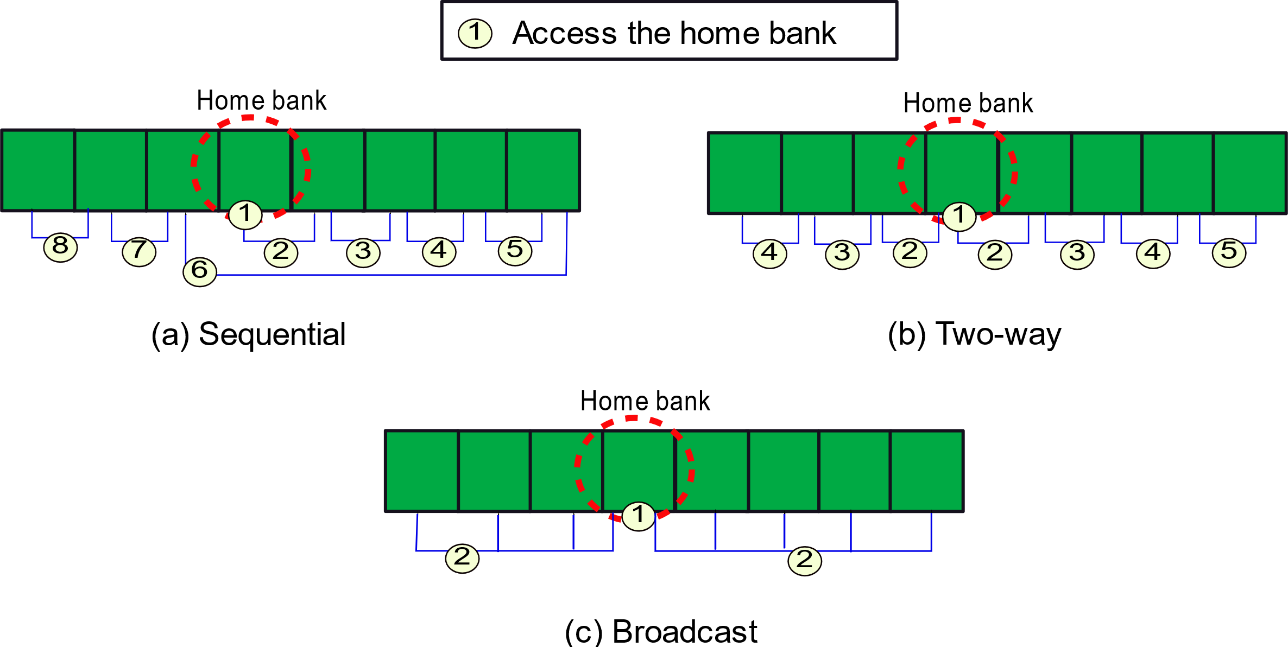
Search Strategies: Start from the home bank (closest to the core in the bank set)

Slide 118
After a Hit/Miss Decision
Hit decision
Send the block to the requesting core
Promote the block → Move it closer to the home bank (Migration)
Bring it to a nearer bank (closer to the home bank)
If there is an empty block in the set in the new bank → no problem
Otherwise swap the blocks
Bringing blocks closer to the home bank (consistent with temporal locality)
Miss decision
Fetch the block from the lower level
Either insert it into the nearest bank or the farthest bank (depends on the strategy)

Slide 119
Eviction and Migration
Assume that a block needs to be evicted
Solution 1: Move it to the lower level
Solution 2: Move it away from the home bank. Need to tag each line with the id of the requesting core
Advantages
Keeps data close to the requesting cores
Brings data closer depending upon usage
Gives a block multiple chances → Upon an eviction move it to bank slightly further away
Search policy, location, migration and eviction are important design decisions

Slide 120
Advanced Designs
Private data → Store it only within the bank in the tile
Shared data → Use SNUCA
Read-only data → Replicate
Advantages:
Limited replication ensures good instruction hit rates
Replicating all data is tricky → need to synchronize replicas

Slide 121
Contents
1.
Overview of an NoC
2.
Message Transmission
3.
Routing
4.
Design of a Router
5.
Non-Uniform Cache Architectures
6.
Performance Aspects

Slide 122
Performance Evaluation Techniques
Evaluation Metrics
Latency
Throughput
Energy or Power
Area and routing complexity
Simulators
Architectural Simulators
Trace based
Dynamic workload based
Standalone Simulators
Synthetic traffic based

Slide 123
Architectural Simulation
Program
Traces of network data + addresses
Simulate NoC
Simulate the network routers and links.
Get latency, throughput, and power/energy statistics.
Can
simulate NoCs accurately for real workloads
Slow

Slide 124
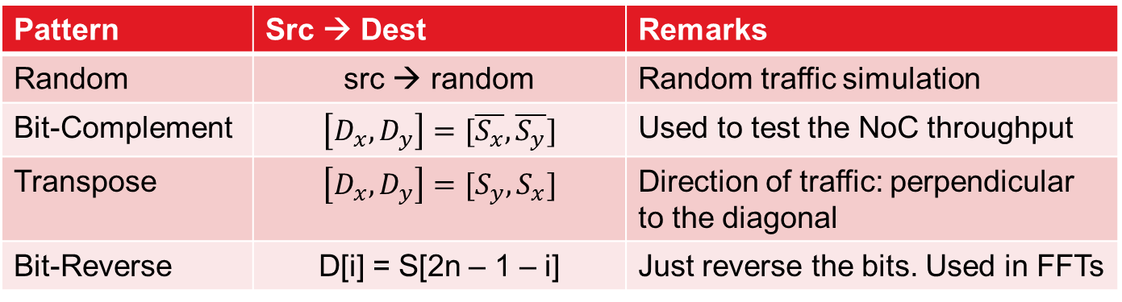
Synthetic Traffic Generation
Consider a mesh (for the sake of simplicity)
Every node has an (x,y) coordinate
Synthetic traffic: set of source→destination pairs
S
D
S_{x}
S_{y}
D_{x}
D_{y}
Simple Patterns
Pattern | Src → Dest | Remarks
Random | src → random | Random traffic simulation
Bit-Complement | $$\left[D_{x}, D_{y}\right]=[\overline{S_{x}},\overline{S_{y}}]$$ | Used to test the NoC throughput
Transpose | $$\left[D_{x}, D_{y}\right]=[S_{y}, S_{x}]$$ | Direction of traffic: perpendicular to the diagonal
Bit-Reverse | D[i] = S[2n – 1 – i] | Just reverse the bits. Used in FFTs

Slide 125
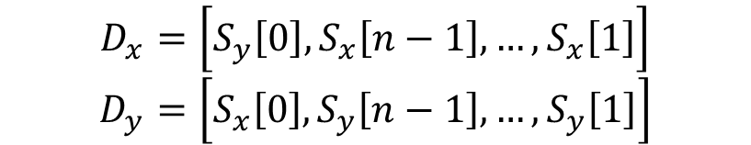
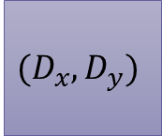
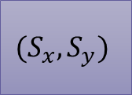
Bit-Rotation
Similar to a right shift.
$$(S_{x}, S_{y})$$
$$(D_{x}, D_{y})$$
$$D_{x}=\left[S_{y}\left[0\right], S_{x}\left[n−1\right], …, S_{x}\left[1\right]\right]$$
$$D_{y}=\left[S_{x}\left[0\right], S_{y}\left[n−1\right], …, S_{y}\left[1\right]\right]$$

Slide 126
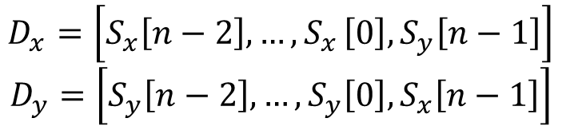
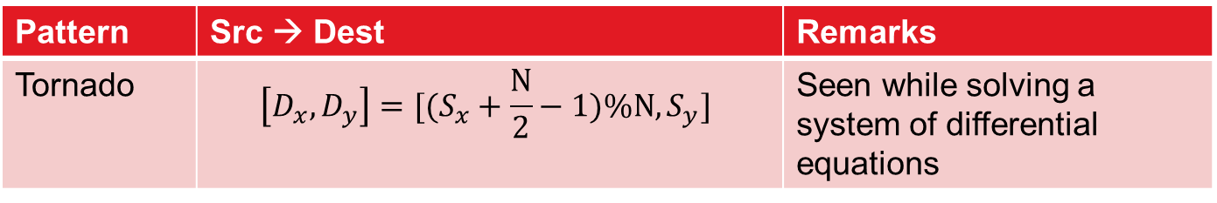
Shuffle and Tornado Patterns
Shuffle
Similar to a left shift.
$$D_{x}=\left[S_{x}\left[n−2\right], {…,S}_{x}\left[0\right], S_{y}\left[n−1\right]\right]$$
$$D_{y}=\left[S_{y}\left[n−2\right], …,S_{y}\left[0\right], S_{x}\left[n−1\right]\right]$$
Pattern | Src → Dest | Remarks
Tornado | $$\left[D_{x}, D_{y}\right]=[(S_{x}+\frac{N}{2}−1)\%N, S_{y}]$$ | Seen while solving a system of differential equations

Slide 127
Faster approach: Synthetically generate traffic

Slide 128
Conclusion
Modern NoCs have a complex network of nodes and
links. Hierarchy: message → packet → flit → phit
Key issues in NoCs: deadlocks, livelocks, starvation
Deadlock-free routing protocols avoid some turns. This stops a
clockwise and anti-clockwise cycle from forming.
The router has five stages: BW → RC → VA → SA → ST
For evaluating the performance of an NoC, we use
trace-based simulation or use synthetic traffic generators.

Slide 129
The End

